Slide 1
Multipath TCP
Homework 3

Slide 2
Limitations of TCP
Doesn’t support multihoming, mobility
TCP is not designed for change of IP address

Slide 3
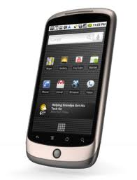
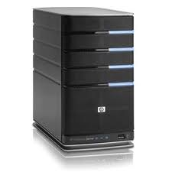
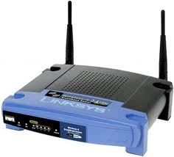
What technology provides today
3G celltower
IP 1.2.3.4

Slide 4
What technology provides
3G celltower
IP 1.2.3.4
IP 5.6.7.8

Slide 5
What technology provides today
3G celltower
IP 1.2.3.4
IP 5.6.7.8
When IP addresses change TCP connections have to be re-established !

Slide 6
Multipath TCP
Multipath TCP is an evaluation of TCP that can effectively use multiple paths within a single transport connection.
If there is a path that TCP would work, MPTCP should work.
MPTCP solves 2 problems :
Combine 2 connections together, Allows one device to use simultaneously 2 different connections, combine them together at the transport layer into stream that higher level protocols can use them without worrying about details.
Path diversity: if one path is slow, MPTCP will try to direct more traffic down to other connection.
Add/remove connection
Raiciu, Costin, et al. "Opportunistic mobility with multipath TCP." Proceedings of the sixth international workshop on MobiArch. ACM, 2011.

Slide 7
Multipath TCP
MPTCP allows a single data-connection to use several interfaces to provide secure stream flow simultaneously.
Handles mobility at transport layer.
Allows failover from one interface to another
Increase the bandwidth due to resource pooling.
Better load-balancing due to fair coupled congestion control.

Slide 8
Multipath TCP : Design objectives
Design objectives
Support unmodified applications
Work over today’s networks (IPv4 and IPv6)
Works in all networks where regular TCP works

Slide 9
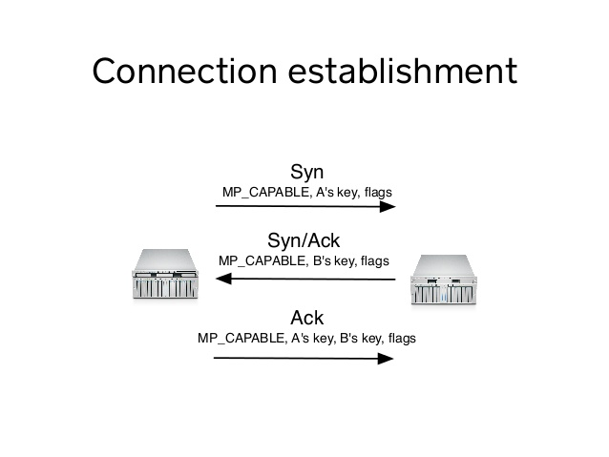
Connection Establishment
How do end-points know they both speak MPTCP?
During the 3-way SYN/SYN-ACK/ACK handshake
A connection is initiated by the mobile host performing the TCP 3-way handshake with the remote host. A TCP option in the SYN and SYN/ACK signals MPTCP capability of the endpoints as well as other relevant MPTCP information.
Once the MPTCP connection is established, there are two basic mobility events that can occur: a new interface is available, or an existing interface ceases to be available.

Slide 10
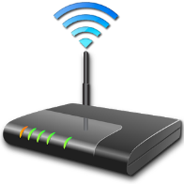

Architectural Principales
MPTCP is a set of extensions to TCP that allow a pair of hosts to negotiate MPTCP use, and then to establish multiple parallel subflows using multiple IP addresses for a single connection.
Application
socket
Application
Multipath TCP
Transport
TCP1
TCP2
TCPn
Network
...
Datalink
Physical
A. Ford, C. Raiciu, M. Handley, S. Barre, and J. Iyengar, “Architectural guidelines for Multipath TCP development", RFC6182 2011.

Slide 11
The Implementation
Application Layer
Standard socket API
Transport Layer
Connection establishment
Is the peer MPTCP-Capable ?
Master subsocket
TCP
subflow
Network Layer

Slide 12
Establishing a connection
Application Layer
Standard socket API
Transport Layer
Meta-socket
Multipath TCP
Creating new subflows
Master subsocket
TCP
subflow
Slave
subsocket
TCP
subflow
Slave
subsocket
TCP
subflow
Network Layer

Slide 13
Establishing Connection
Initial Connection
Subflow
3Way Handshake with KEY Exchange
Traditional TCP connection is established if peer is not MP_CAPABLE
SYN Request is sent with MP_JOIN which includes the HMAC which is secured with SHA1 to provide authentication

Slide 14
Multi Homing
Hosts can be notified about new addresses by using MP_JOIN where a new subflow is also added to the existing connection
ADD_ADDR message can be sent to the other end for further use by other end whenever necessary
REMOVE_ADDR is used to notify the other end about the loss of existing IP Address for further use

Slide 15
Features
Priority of the existing flows can be controlled using MP_PRIO message
The connection is closed using DATA_SEQUENCE_SIGNAL

Slide 16
Redundancy and Mobility
Benefits of MPTCP for mobile devices lie in the ability to enhance the use of more than one interface in a redundant manner
It is possible for a mobile client to move seamlessly between networks,
MPTCP maintains application session with a mobile node (MN) whose IP point of attachment to the network changes during the application session which provides an opportunity to manage mobility

Slide 17
Notes
The subflow can be initiated when the first connection is physically cut but the MPTCP connection still remains in the OS
How?
The subflows only uses the keys agreed during initial setup
The second address is not confirmed through first flow during connection establishment

Slide 18
THANK YOU!

